Slide 1
Machine Learning
Where to start?

Slide 2
AI Umbrella
Artificial intelligence
Machine learning
Deep learning

Slide 3
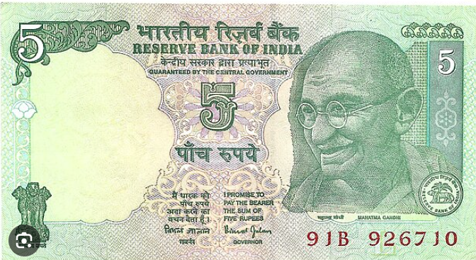

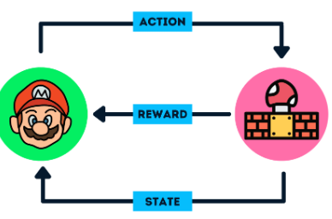

Machine Learning Models
Supervised Learning
Unsupervised Learning
Reinforced Learning
Categorical Values (Classification):
Labels
Classes
Clustering Techniques
Continuous Values (Regression):
Continuous values

Slide 4
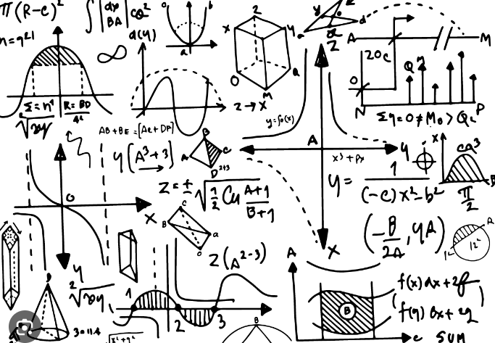

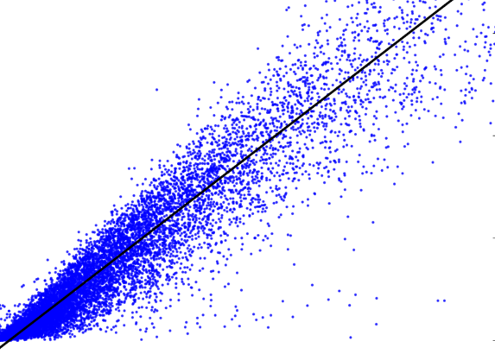
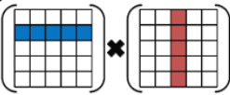
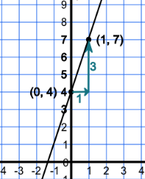
Linear Regression
Let us crawl to Data Science

Slide 5


Linear Algebra
2D Space
(6, 4)
(2, 2)
rise
run
$$m= \frac{y_{2}−y_{1}}{x_{2}−x_{1}}$$
}
c
(-4, -1)
rise
run
$$y=mx+c$$

Slide 6
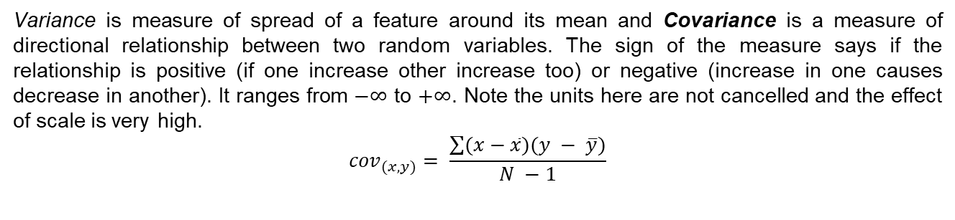
Covariance & Correlation
How to check if there is any relationship between two variables?
If there is a relationship, how strong is it?
Do we know which variable is dependent?
Variance is measure of spread of a feature around its mean and Covariance is a measure of directional relationship between two random variables. The sign of the measure says if the relationship is positive (if one increase other increase too) or negative (increase in one causes decrease in another). It ranges from $−∞$ to $+∞$. Note the units here are not cancelled and the effect of scale is very high.
$${cov}_{(x, y)}= \frac{\sum{(x−\overline{x})(y − \overline{y})}}{N −1}$$
Positive relation
Negative relation
No relation

Slide 7
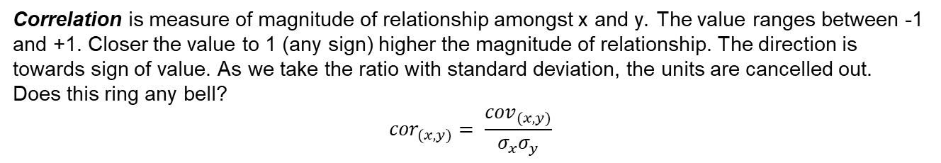
Causation
Correlation is measure of magnitude of relationship amongst x and y. The value ranges between -1 and +1. Closer the value to 1 (any sign) higher the magnitude of relationship. The direction is towards sign of value. As we take the ratio with standard deviation, the units are cancelled out.
Does this ring any bell?
$${cor}_{(x, y)}= \frac{{cov}_{(x, y)}}{σ_{x}σ_{y}}$$
What causes what is a serious question and cannot be ignored.
The correlation and covariance does not prove causation.
The relationship is genuine of just by chance?
A simple example to quote: The sunburns are observed whenever the ice-cream sales go high.
Does this mean that ice-cream sales and sunburns are related?
There is a third variable which is not in picture. The season which causes both to increase.

Slide 8



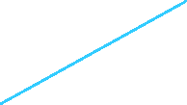
Linear Regression
We have to find an equation like $\hat{y}= β_{1}x+β_{0}$, for which we should evaluate the slope $β_{1}$ and intercept $β_{0}$.
Dependent feature
$$β_{1}$$
$$β_{0}$$
Independent feature

Slide 9
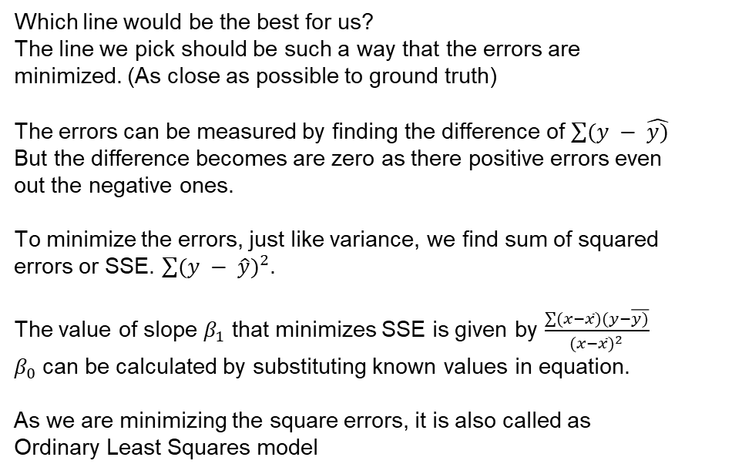
Line of best fit
Which line would be the best for us?
The line we pick should be such a way that the errors are minimized. (As close as possible to ground truth)
The errors can be measured by finding the difference of $\sum{(y − \hat{y)}}$ But the difference becomes are zero as there positive errors even out the negative ones.
To minimize the errors, just like variance, we find sum of squared errors or SSE. $\sum{{(y − \hat{y})}^{2}}$.
The value of slope $β_{1}$ that minimizes SSE is given by $\frac{\sum{(x−\overline{x})(y−\overline{y)}}}{{(x−\overline{x})}^{2}}$
$β_{0}$ can be calculated by substituting known values in equation.
As we are minimizing the square errors, it is also called as Ordinary Least Squares model
Dependent feature
Independent feature

Slide 10
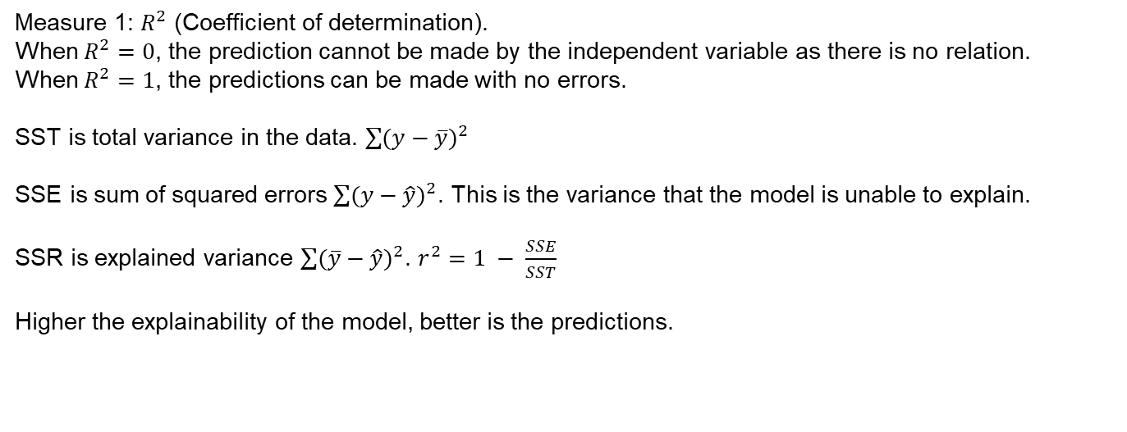
How to measure if the model is good?
Measure 1: $R^{2}$ (Coefficient of determination).
When $R^{2}=0$, the prediction cannot be made by the independent variable as there is no relation.
When $R^{2}=1$, the predictions can be made with no errors.
SST is total variance in the data. $\sum{{(y−\overline{y})}^{2}}$
SSE is sum of squared errors $\sum{{(y−\hat{y})}^{2}}$. This is the variance that the model is unable to explain.
SSR is explained variance $\sum{{(\overline{y}−\hat{y})}^{2}}$. $r^{2}=1 − \frac{SSE}{SST}$
Higher the explainability of the model, better is the predictions.

Slide 11
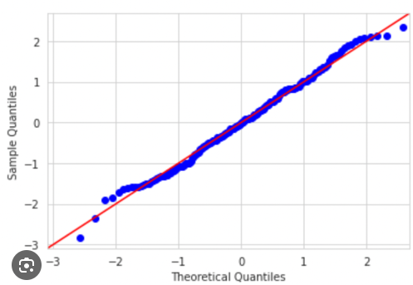
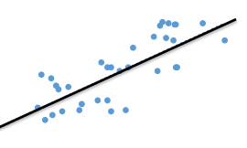
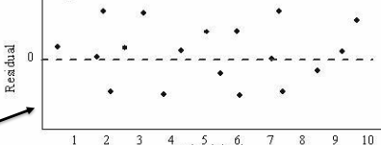
How to measure if the model is good?
Assumptions of regression
There is a linear relationship between the target and independent variable so that the y=mx+b is possible.
The errors made by the model are random and do not have any pattern associated.
The error terms have constant variance (homoscedastic)
The error terms should be normally distributed.

Slide 12
What if the data is not linear?
It is highly likely that the data is not linear or has issues of heteroscedasticity.
In such cases, we can transform the data (like applying square root/log etc).
In few cases, we can try a higher dimensional space (covered in futures lectures)

Slide 13
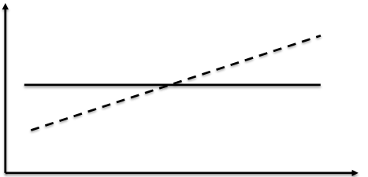
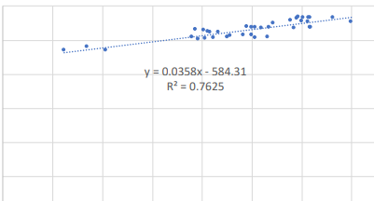
Evaluate slope and overall model outlook.
If there was no relation between the target variable and the independent variable, the 2D plot would have been a flat line parallel to x-axis. Given a case where the correlation and covariance indicate that relation exists, then slope should be non-zero.

Slide 14
Hypothesis testing
First we state our hypothesis.
What we want to prove here is that an independent variable has some impact on target and can be used for predicting.
So the null hypothesis would be something like “there is no relationship, so the slope of line is zero”
When the slope is zero, the independent variable has no effect on target.
The alternate hypothesis would be like “The independent variable has some effect on target and hence the slope is non-zero”
Compute t-statistic and p-value
If p-value is less than the error metric (0.05 or also said as 95% confidence) the reject null hypothesis.
Accept the alternate stating, there is significant relation between independent and target
Git Code
https://github.com/sanjeev-kallepalli/training/blob/main/t_test.ipynb

Slide 15
Important Notes
Linear regression works only when there is linear relationship (at least approximately)
R² alone is not sufficient to determine if model is good.
Hypothesis testing is required to prove the statistical evidence.
There might be cases where R² is well above 90% but the p-value and F-value are not significant.
Caution is required before interpreting the results on prod data.
Linear regression is highly impacted by outliers.

